Slide 1
WHY
Business Challenges
Use Case Description
KPIs Impacted
Modern software engineering and IT operations teams face growing complexity, resource constraints, and rising delivery expectations:
Development Challenges
40–50% of developer time is spent on repetitive tasks (boilerplate code, writing tests, documentation).
Manual code reviews are inconsistent, time‑consuming, and often delayed.
Teams lack consistent standards, creating technical debt.
IT Operations Challenges
High volume of repeat incidents and support tickets (password resets, service restarts, log errors).
Reactive operations increase MTTR and risk service disruptions.
Lack of centralized intelligence across logs and telemetry makes RCA difficult.
Below are the core use cases leveraging Azure AI Agents and GitHub ecosystem:
Use Case 1: AI-Assisted Code Generation & Documentation
Use Case 2: Automated Code Review Agent
Use Case 3: IT Ticket Auto‑Triage and Auto‑Resolution
Use Case 4: AI Log Analytics & Proactive Incident Detection.
Faster feature delivery Remove bottlenecks Higher system uptime Improved operational efficiency Better reliability Stronger maintainability
Business Impact
Faster time‑to‑market for new features Reduced operational expenditure (OPEX) Higher platform stability and compliance Increased developer & IT staff satisfaction Stronger alignment to Digital Transformation goals
WHO
HOW
Stakeholders
Functional Solution
Technical Solution
Developers
DevOps/SRE
IT Support (L1/L2)
Enterprise Architects
Product Owners
CIO / CTO
Developer Workflow Automation
IT Operations Automation
Multi-Agent Orchestration
Governance, Safety & Approvals
Azure AI Agent Service
Azure OpenAI GPT‑4.1 / GPT‑4o / o1
Azure Monitor & Log Analytics
Azure Logic Apps
Azure Functions/Automation Runbooks
Azure Key Vault
Private Endpoints/ VNet

Slide 2
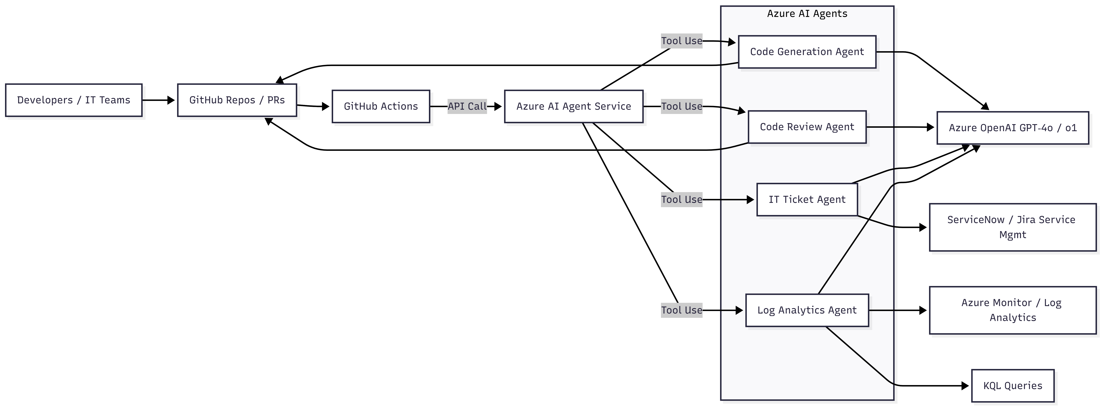
High Level Architecture Diagram

Slide 3
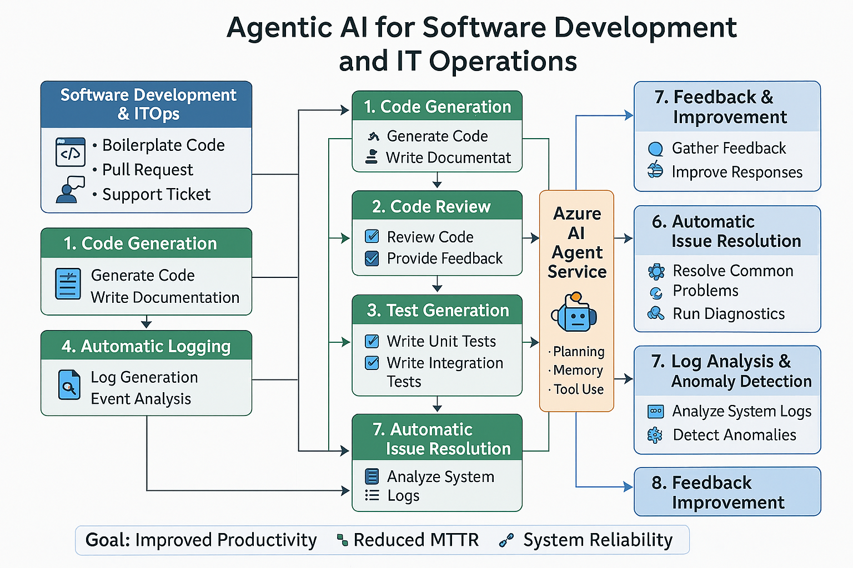
Technical Solution
Technologies
Azure AI Agent Service: Multi-agent orchestration
Azure OpenAI GPT‑4.1 / GPT‑4o / o1: Reasoning, code generation, log analysis
Azure Monitor & Log Analytics: Telemetry source
Azure Logic Apps: ITSM integrations
Azure Functions / Automation Runbooks: Auto-remediation actions
Azure Key Vault: Secrets management
Private Endpoints / VNet: Secure AI‑model access
GitHub Actions: trigger AI workflows
GitHub Apps allow AI agents to post PR comments
Branch protection & policy enforcement with AI validation

